Slide 1
Locating an Ideal Neighborhood for Small Business in Atlanta, GA
Applied Data Science Capstone
Sravan Neela

Slide 2
Venue Placement for Small Businesses
Small business often struggles during their initial years (1-5yrs) due to several factors that eventually lead them to failure.
Some reasons are more common than others such as market needs, location, demography.
This analysis will try to increase the odds of business success by considering demographic factors for ideal placement of a small business from a range of options.

Slide 3
The (Small) Business Problem
The objective of this analysis is to find relatively safe and potentially profitable location in the city of Atlanta, GA to start a small business.
Recommend from common venues such as restaurants, sports bar, coffee shops, saloon or a spa will be explored.
Analysis will use city data such as crime reports, demographics and location data from foursquare API.
Analysis concludes with providing insights into an ideal neighborhood to start a small business.

Slide 4
Data Acquisition and Cleaning
Following data sources were used for the analysis:
Atlanta city crime data to identify safe locations
GIS data from Atlanta Department of City Planning to obtain geographical information
Census data from City of Atlanta to get neighborhood demographics such as median income, population and median home values by (Neighborhood planning units) NPU.
Finding most common and least common venues in proximity of an ideal location using Foursquare API.

Slide 5
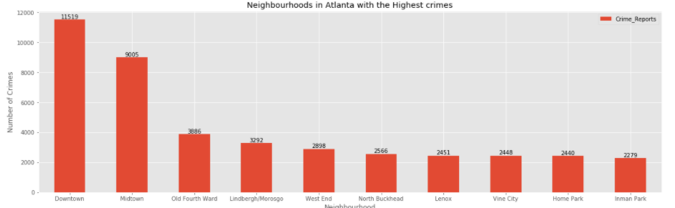
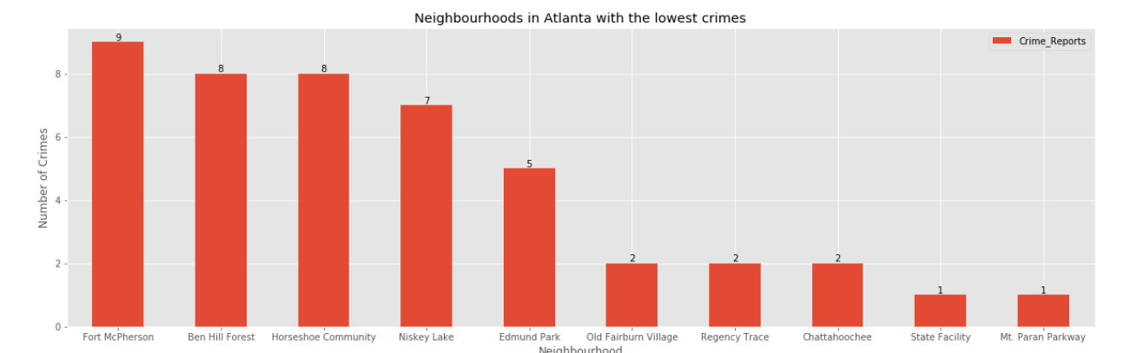
Crime Reports by Neighborhood
Analyzing crime reports in Atlanta for last 3 years.
Neighborhoods with highest and lowest crimes
Provides insights into relative crime rates among Atlanta’s neighborhood.

Slide 6
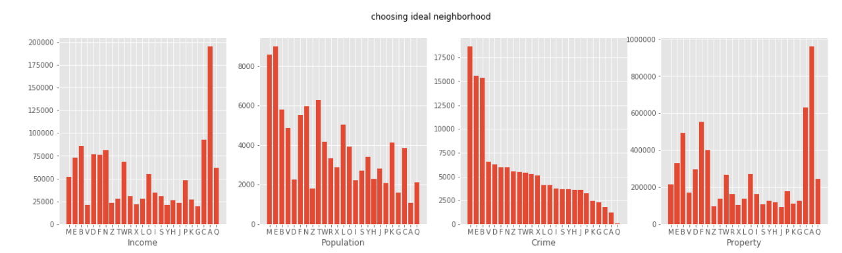
Demographics
Importing census data to analyze and visualize demographic information

Slide 7
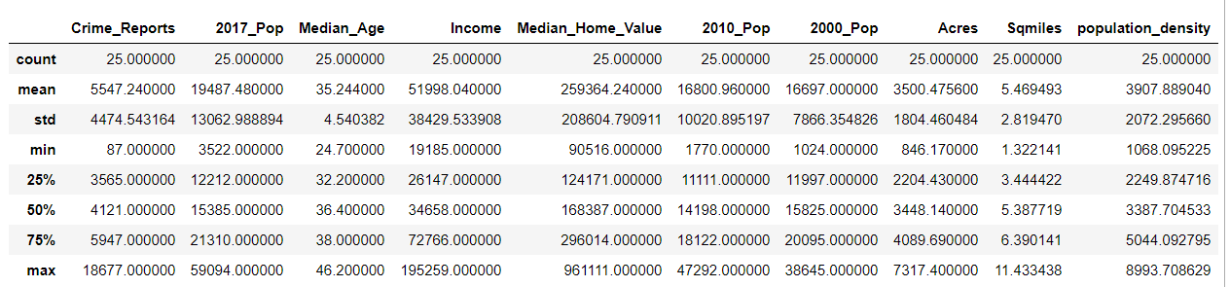
Modelling
Using data descriptions to understand the nature of the dataset.
Apply a criteria to narrow down the neighborhoods that can bring more success to small businesses.

Slide 8
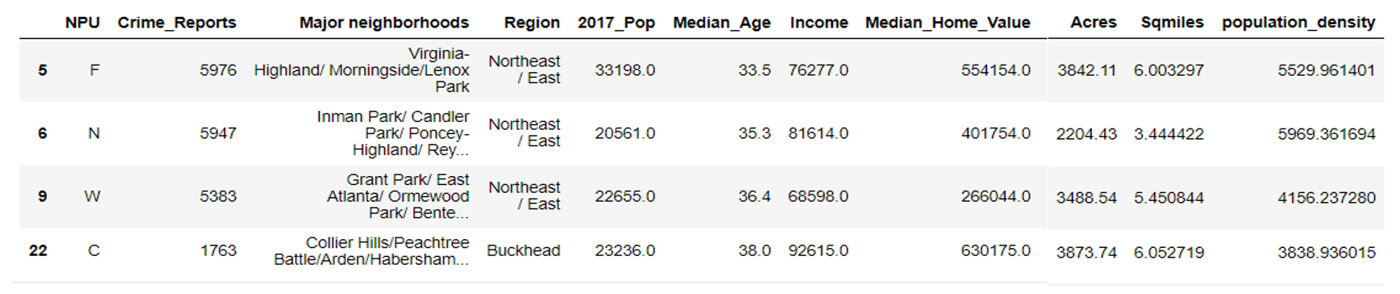
Narrow Down Criteria
Once required datasets were imported, merging and then sorting the data set with the following criteria
Median income >$65000/yr
Population density > 3000/sq-mile
Crime Reports for the last 3 yrs. <6000

Slide 9
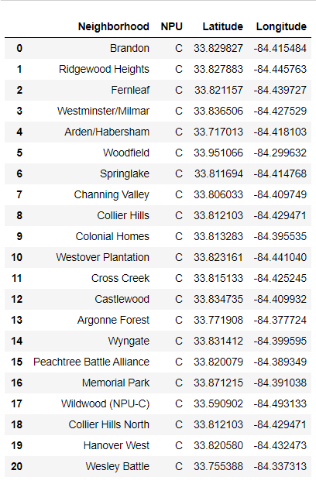
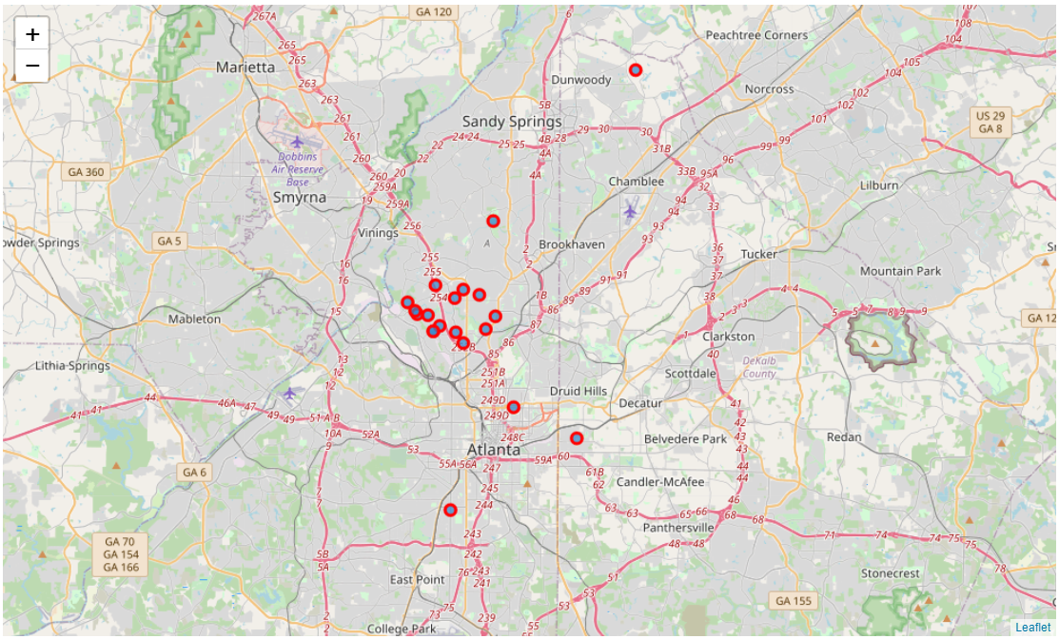
Neighborhood Group with Lowest Crimes

Slide 10
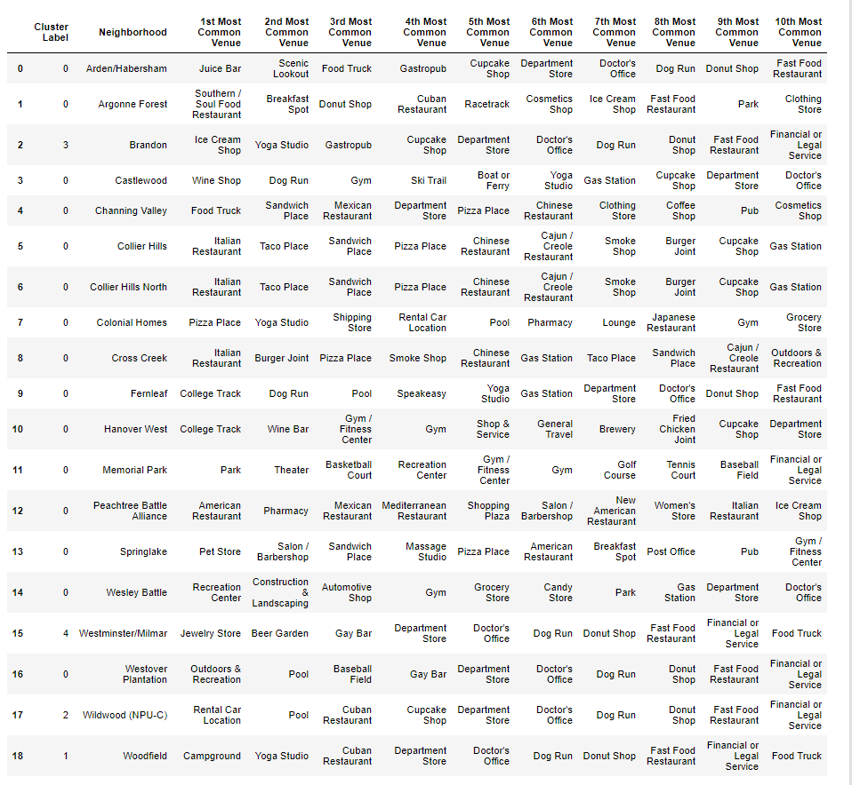
Most Common Venues
Gather most common venues in NPU C With the data available from foursquare API.

Slide 11
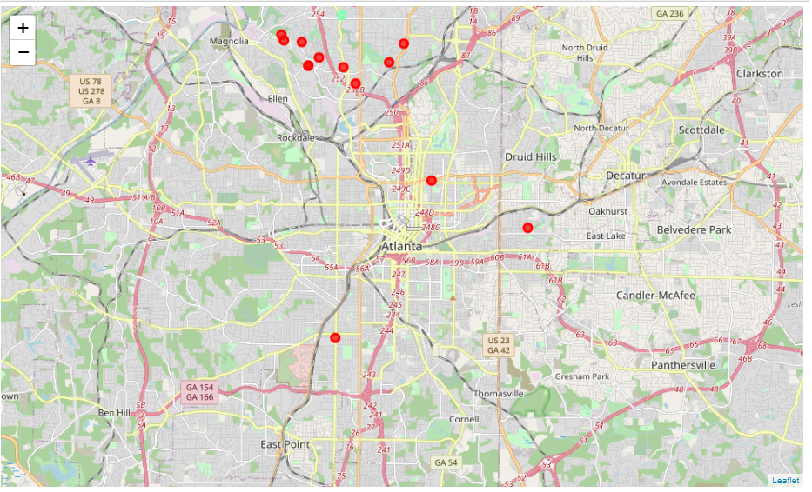
Clustering with K-Means
Used K-Means Clustering in NPU C for venues in the area.
Using K=5, 5 clusters were created with most common venues found in the area.
Map shows venues clustered across NPU C

Slide 12
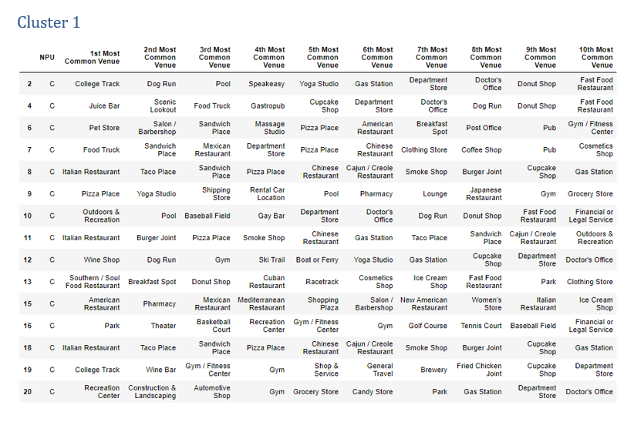
Results

Slide 13
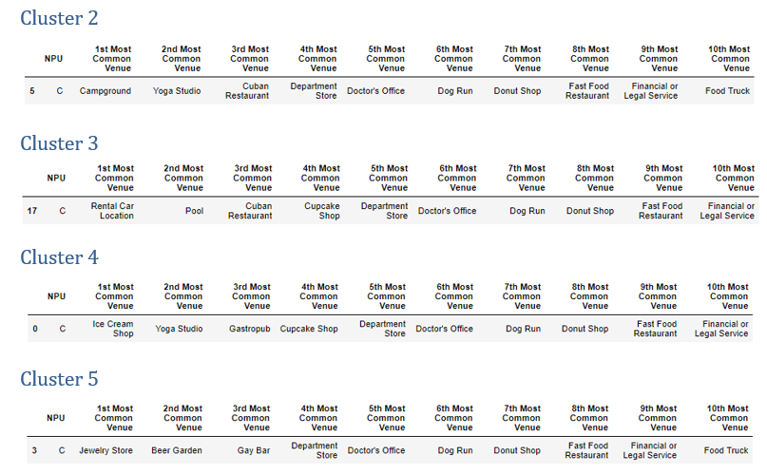
Results

Slide 14
Conclusion & Future Work
Through the analysis, insights were offered into the city of Atlanta.
Small entrepreneurs can use the analysis to find a safe and profitable location that suits them the most.
K-means clustering was used to find the common venues in each neighborhood.
Several small businesses options are available, one can pick the least common venues.
The analysis can be further extended to explore demographics to cater to a specific group e.g. pick a Sports bar vs Premium Spa

